Slide 1
Principles of Parallel Algorithm Design

Slide 2
Introduction 1
A parallel algorithm is a recipe that tells us how to solve a given problem using multiple processors.
However, specifying a parallel algorithm involves more than just specifying the steps.
At the very least, a parallel algorithm has the added dimension of concurrency and the algorithm designer must specify sets of steps that can be executed simultaneously.
This is essential for obtaining any performance benefit from the use of a parallel computer.

Slide 3
Introduction 2
In practice, specifying a nontrivial parallel algorithm may include some or all of the following:
Identifying portions of the work that can be performed concurrently.
Mapping the concurrent pieces of work onto multiple processes running in parallel.
Distributing the input, output, and intermediate data associated with the program.
Managing accesses to data shared by multiple processors.
Synchronizing the processors at various stages of the parallel program execution.
Notes:
Trivial Problems or Algorithms: These are relatively simple and straightforward tasks that may not require parallel processing. Nontrivial Problems or Algorithms: These are more complex tasks that can benefit from parallel processing, but designing an effective parallel algorithm for them is not straightforward.

Slide 4
Introduction 3
Typically, there are several choices for each of the above steps, but usually, relatively few combinations of choices lead to a parallel algorithm that yields performance commensurate with the computational and storage resources employed to solve the problem.
Often, different choices yield the best performance on different parallel architectures or under different parallel programming paradigms.

Slide 5
Preliminaries
Section 3.1

Slide 6
Preliminaries
To design a parallel algorithms two things are essential at least.
Divide a computation into smaller computations
Assigning them to different processors.
In this section we will talk about the two issues mentioned above using suitable examples.

Slide 7
Decomposition, Tasks, and Dependency Graphs
Decomposition is the process of dividing a computation into smaller parts, some or all of which may potentially be executed in parallel.
Tasks are programmer-defined units of computation into which the main computation is subdivided by means of decomposition.
Simultaneous execution of multiple tasks is the key to reducing the time required to solve the entire problem.
Tasks can be of arbitrary size, but once defined, they are regarded as indivisible units of computation.
The tasks into which a problem is decomposed may not all be of the same size.

Slide 8
Example 1: Dense matrix vector multiplication
Consider the multiplication of a dense n x n matrix A with a vector b to yield another vector y.
The ith element y[i] of the product vector is the dot-product of the ith row of A with the input vector b;
The computation of each y[i] can be regarded as a task.
Alternatively, as shown later, the computation could be decomposed into fewer, say four, tasks where each task computes roughly n/4 of the entries of the vector y.

Slide 9
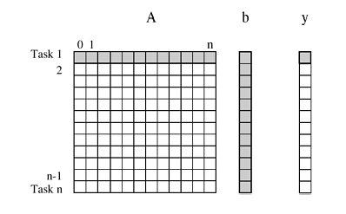
Example 1: Dense matrix vector multiplication
Notes:
Decomposition of dense matrix-vector multiplication into n tasks, where n is the number of rows in the matrix. The
portions of the matrix and the input and output vector accessed by Task 1 are highlighted.

Slide 10
Example 1: Dense matrix vector multiplication
Note that all tasks are independent and can be performed all together or in any sequence.
However, in general, some tasks may use data produced by other tasks and thus may need to wait for these tasks to finish execution.
An abstraction used to express such dependencies among tasks and their relative order of execution is known as a task dependency graph.
A task-dependency graph is a directed acyclic graph in which the nodes represent tasks and the directed edges indicate the dependencies amongst them.
The task corresponding to a node can be executed when all tasks connected to this node by incoming edges have completed.
Note that task-dependency graphs can be disconnected and the edge set of a task-dependency graph can be empty.
This is the case for matrix-vector multiplication, where each task computes a subset of the entries of the product vector.

Slide 11
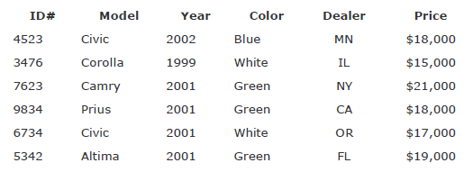
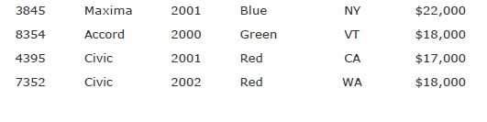
Example 2: Database query processing

Slide 12
Example 2: Database query processing
Each row of the table is a record that contains data corresponding to a particular vehicle, such as its ID, model, year, color, etc. in various fields.
Consider the computations performed in processing the following query:
MODEL="Civic" AND YEAR="2001" AND (COLOR="Green" OR COLOR="White")
This query looks for all 2001 Civics whose color is either Green or White.

Slide 13
Example 2: Database query processing
On a relational database, this query is processed by creating a number of intermediate tables.
One possible way is to first create the following four tables: a table containing all Civics, a table containing all 2001-model cars, a table containing all green-colored cars, and a table containing all white-colored cars.
Next, the computation proceeds by combining these tables by computing their pairwise intersections or unions.
In particular, it computes the intersection of the Civic-table with the 2001-model year table, to construct a table of all 2001-model Civics.
Similarly, it computes the union of the green- and white-colored tables to compute a table storing all cars whose color is either green or white.
Finally, it computes the intersection of the table containing all the 2001 Civics with the table containing all the green or white vehicles and returns the desired list.

Slide 14
Example 2: Database query processing
The various computations involved in processing the query can be visualized by the task-dependency graph shown in Figure on next slide.
Each node in this figure is a task that corresponds to an intermediate table that needs to be computed and the arrows between nodes indicate dependencies between the tasks.
For example, before we can compute the table that corresponds to the 2001 Civics, we must first compute the table of all the Civics and a table of all the 2001-model cars.

Slide 15
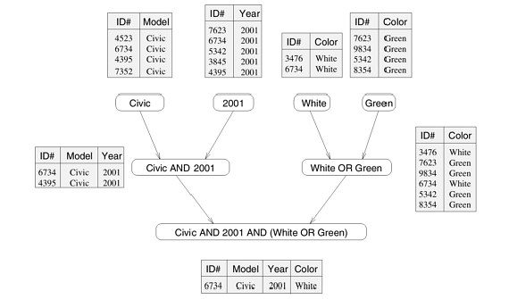
Example 2: Database query processing

Slide 16
Example 2: Database query processing
Note that often there are multiple ways of expressing certain computations, especially those involving associative operators such as addition, multiplication, and logical AND or OR.
Different ways of arranging computations can lead to different task-dependency graphs with different characteristics.
For instance, the database query can be solved by first computing a table of all green or white cars, then performing an intersection with a table of all 2001 model cars, and finally combining the results with the table of all Civics.
This sequence of computation results in the task-dependency graph shown in next slide.

Slide 17
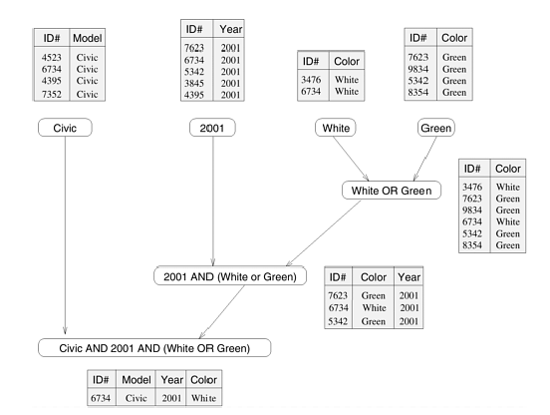
Example 2: An alternate data-dependency graph

Slide 18
Granularity, Concurrency, and Task-Interaction
The number and size of tasks into which a problem is decomposed determines the granularity of the decomposition.
A decomposition into a large number of small tasks is called fine-grained and a decomposition into a small number of large tasks is called coarse-grained.
Fine-grained require relatively low computation time and have minimal dependencies between them. Coarse-grained tasks are generally more independent and have higher computational requirements.
For example, the decomposition for matrix-vector multiplication shown previously would usually be considered fine-grained because each of a large number of tasks performs a single dot-product.
Figure in the next slide shows a coarse-grained decomposition of the same problem into four tasks, where each tasks computes n/4 of the entries of the output vector of length n.

Slide 19
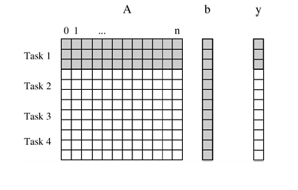
Coarse-grained decomposition

Slide 20
Granularity, Concurrency, and Task-Interaction
A concept related to granularity is that of degree of concurrency.
The maximum number of tasks that can be executed simultaneously in a parallel program at any given time is known as its maximum degree of concurrency.
In most cases, the maximum degree of concurrency is less than the total number of tasks due to dependencies among the tasks.
For example, the maximum degree of concurrency in the task-graphs (database query) is four.
In these task-graphs, maximum concurrency is available right at the beginning when tables for Model, Year, Color Green, and Color White can be computed simultaneously.
In general, for task dependency graphs that are trees, the maximum degree of concurrency is always equal to the number of leaves in the tree.

Slide 21
Granularity, Concurrency, and Task-Interaction
A more useful indicator of a parallel program's performance is the average degree of concurrency, which is the average number of tasks that can run concurrently over the entire duration of execution of the program.
Both the maximum and the average degrees of concurrency usually increase as the granularity of tasks becomes smaller (finer).
For example, the decomposition of matrix-vector multiplication has a fairly small granularity and a large degree of concurrency (fine-grained matrix vector multiplication example).
The decomposition for the same problem shown has a larger granularity and a smaller degree of concurrency (coarse grained matrix vector multiplication).

Slide 22
Granularity, Concurrency, and Task-Interaction
A feature of a task-dependency graph that determines the average degree of concurrency for a given granularity is its critical path.
In a task-dependency graph, let us refer to the nodes with no incoming edges by start nodes and the nodes with no outgoing edges by finish nodes.
The longest directed path between any pair of start and finish nodes is known as the critical path.
The sum of the weights of nodes along this path is known as the critical path length, where the weight of a node is the size or the amount of work associated with the corresponding task.
The ratio of the total amount of work to the critical-path length is the average degree of concurrency.
Therefore, a shorter critical path favors a higher degree of concurrency.

Slide 23
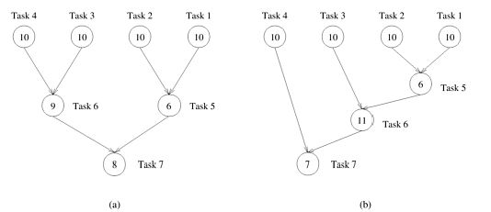
Granularity, Concurrency, and Task-Interaction
Notes:
the critical path length is 27 in the task-dependency graph shown in (a) is 34 in the task-dependency graph shown in (b).
Since the total amount of work required to solve the problems using the two decompositions is 63 and 64, respectively, the
average degree of concurrency of the two task-dependency graphs is 2.33 and 1.88 respectively.

Slide 24
Granularity, Concurrency, and Task-Interaction
Although it may appear that the time required to solve a problem can be reduced simply by increasing the granularity of decomposition and utilizing the resulting concurrency to perform more and more tasks in parallel, this is not the case in most practical scenarios.
Usually, there is an inherent bound on how fine-grained a decomposition a problem permits.
For instance, there are n^2 multiplications and additions in matrix-vector multiplication and the problem cannot be decomposed into more than O(n2) tasks even by using the most fine-grained decomposition.

Slide 25
Granularity, Concurrency, and Task-Interaction
Other than limited granularity and degree of concurrency, there is another important practical factor that limits our ability to obtain unbounded speedup (ratio of serial to parallel execution time) from parallelization.
This factor is the interaction among tasks running on different physical processors.
The tasks that a problem is decomposed into often share input, output, or intermediate data. The dependencies in a task-dependency graph usually result from the fact that the output of one task is the input for another.
For example, in the database query example, tasks share intermediate data; the table generated by one task is often used by another task as input.

Slide 26
Granularity, Concurrency, and Task-Interaction
Depending on the definition of the tasks and the parallel programming paradigm, there may be interactions among tasks that appear to be independent in a task dependency graph.
For example, in the decomposition for matrix-vector multiplication, although all tasks are independent, they all need access to the entire input vector b.
Since originally there is only one copy of the vector b, tasks may have to send and receive messages for all of them to access the entire vector in the distributed-memory paradigm.

Slide 27
Granularity, Concurrency, and Task-Interaction
The pattern of interaction among tasks is captured by what is known as a task-interaction graph.
The nodes in a task-interaction graph represent tasks and the edges connect tasks that interact with each other.
The nodes and edges of a task-interaction graph can be assigned weights proportional to the amount of computation a task performs and the amount of interaction that occurs along an edge, if this information is known.
The edges in a task interaction graph are usually undirected, but directed edges can be used to indicate the direction of flow of data, if it is unidirectional.
The edge-set of a task-interaction graph is usually a superset of the edge-set of the task-dependency graph.
In the database query example discussed earlier, the task-interaction graph is the same as the task-dependency graph.

Slide 28
Decomposition techniques

Slide 29
Decomposition Techniques
We will study some decomposition techniques to achieve concurrency.
These are not all possible decomposition techniques and given decomposition techniques is not always guaranteed to achieve best parallelism.
Broadly classified into four categories:
i. Recursive Decomposition ii. Data Decomposition
iii. Exploratory Decomposition iv. Speculative Decomposition
Recursive and Data decomposition techniques are general purpose.
Speculative and Exploratory decomposition techniques are special purpose.

Slide 30
Decomposition Techniques-Recursive Decomposition
Recursive decomposition is a method for inducing concurrency in problems that can be solved using the divide-and-conquer strategy.
In this technique, a problem is solved by first dividing it into a set of independent subproblems.
Each one of these subproblems is solved by recursively applying a similar division into smaller subproblems followed by a combination of their results.
The divide-and-conquer strategy results in natural concurrency, as different subproblems can be solved concurrently.

Slide 31
Recursive decomposition- example(Quick sort)
Consider the problem of sorting a sequence A of n elements using the commonly used quicksort algorithm.
Quicksort is a divide and conquer algorithm that starts by selecting a pivot element x and then partitions the sequence A into two subsequences A0 and A1 such that all the elements in A0 are smaller than x and all the elements in A1 are greater than or equal to x.
This partitioning step forms the divide step of the algorithm.
Each one of the subsequences A0 and A1 is sorted by recursively calling quicksort.
Each one of these recursive calls further partitions the sequences.
The recursion terminates when each subsequence contains only a single element.

Slide 32
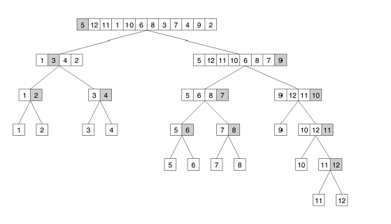
Recursive decomposition- example(Quick sort)

Slide 33
Recursive decomposition- example(Quick sort)
In previous Figure, we define a task as the work of partitioning a given subsequence.
Therefore, Figure also represents the task graph for the problem.
Initially, there is only one sequence (i.e., the root of the tree), and we can use only a single process to partition it.
The completion of the root task results in two subsequences (A0 and A1, corresponding to the two nodes at the first level of the tree) and each one can be partitioned in parallel.
Similarly, the concurrency continues to increase as we move down the tree.

Slide 34
Decomposition Techniques-Data Decomposition
Data decomposition is a powerful and commonly used method for deriving concurrency in algorithms that operate on large data structures.
In this method, the decomposition of computations is done in two steps.
In the first step, the data on which the computations are performed is partitioned, and in the second step, this data partitioning is used to induce a partitioning of the computations into tasks.
The partitioning of data can be performed in many possible ways.
In general, one must explore and evaluate all possible ways of partitioning the data and determine which one yields a natural and efficient computational decomposition.

Slide 35
Decomposition Techniques-Data Decomposition
Partitioning Output Data In many computations, each element of the output can be computed independently of others as a function of the input.
In such computations, a partitioning of the output data automatically induces a decomposition of the problems into tasks, where each task is assigned the work of computing a portion of the output.
We introduce the problem of matrix multiplication to illustrate a decomposition based on partitioning output data.
How can we assume or find that output is not dependent on any input?
Functional Independence → Function applied to each input element does not rely on result of other element.
No Data Dependency → No shared variables or data structure
Lack of Sequential Dependency → Order of processing does not matter

Slide 36
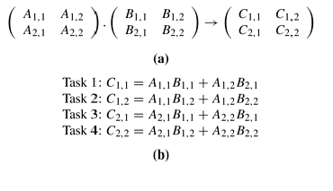
Decomposition Techniques-Data Decomposition

Slide 37
Decomposition Techniques-Data Decomposition
Partitioning Input Data Partitioning of output data can be performed only if each output can be naturally computed as a function of the input.
In many algorithms, it is not possible or desirable to partition the output data.
For example, while finding the minimum, maximum, or the sum of a set of numbers, the output is a single unknown value.
In a sorting algorithm, the individual elements of the output cannot be efficiently determined in isolation.
In such cases, it is sometimes possible to partition the input data, and then use this partitioning to induce concurrency.

Slide 38
Decomposition Techniques-Data Decomposition
Partitioning Input Data
A task is created for each partition of the input data and this task performs as much computation as possible using these local data. Note that the solutions to tasks induced by input partitions may not directly solve the original problem. In such cases, a follow-up computation is needed to combine the results. For example, while finding the sum of a sequence of N numbers using p processes (N > p), we can partition the input into p subsets of nearly equal sizes.
Each task then computes the sum of the numbers in one of the subsets. Finally, the p partial results can be added up to yield the final result.

Slide 39
Decomposition Techniques-Data Decomposition
The problem of computing the frequency of a set of itemsets in a transaction database can also be decomposed based on a partitioning of input data.
Figure in next slide shows a decomposition based on a partitioning of the input set of transactions.
Each of the two tasks computes the frequencies of all the itemsets in its respective subset of transactions.
The two sets of frequencies, which are the independent outputs of the two tasks, represent intermediate results.
Combining the intermediate results by pairwise addition yields the final result.

Slide 40
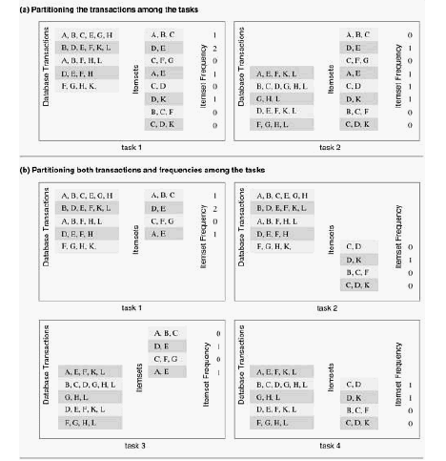
Decomposition Techniques-Data Decomposition

Slide 41
Decomposition Techniques-Data Decomposition
Partitioning both Input and Output Data In some cases, in which it is possible to partition the output data, partitioning of input data can offer additional concurrency.
For example, consider the 4-way decomposition for computing itemset frequencies.
Here, both the transaction set and the frequencies are divided into two parts and a different one of the four possible combinations is assigned to each of the four tasks.
Each task then computes a local set of frequencies. Finally, the outputs of Tasks 1 and 3 are added together, as are the outputs of Tasks 2 and 4.

Slide 42
Decomposition Techniques-Data Decomposition
Partitioning Intermediate Data Algorithms are often structured as multi-stage computations such that the output of one stage is the input to the subsequent stage.
A decomposition of such an algorithm can be derived by partitioning the input or the output data of an intermediate stage of the algorithm.
Partitioning intermediate data can sometimes lead to higher concurrency than partitioning input or output data.
Often, the intermediate data are not generated explicitly in the serial algorithm for solving the problem and some restructuring of the original algorithm may be required to use intermediate data partitioning to induce a decomposition.

Slide 43
Decomposition Techniques-Data Decomposition
The Owner-Computes Rule A decomposition based on partitioning output or input data is also widely referred to as the owner-computes rule.
The idea behind this rule is that each partition performs all the computations involving data that it owns.
Depending on the nature of the data or the type of data-partitioning, the owner-computes rule may mean different things.
For instance, when we assign partitions of the input data to tasks, then the owner-computes rule means that a task performs all the computations that can be done using these data.
On the other hand, if we partition the output data, then the owner-computes rule means that a task computes all the data in the partition assigned to it.

Slide 44
Decomposition Techniques-Exploratory Decomposition
Exploratory decomposition is used to decompose problems whose underlying computations correspond to a search of a space for solutions.
In exploratory decomposition, we partition the search space into smaller parts, and search each one of these parts concurrently, until the desired solutions are found.
The configuration space generated by the tree search is often referred to as a state space graph. Each node of the graph is a configuration and each edge of the graph connects configurations that can be reached from one another by a single move of a tile.
How exploratory decomposition different to data-decomposition?

Slide 45
Decomposition Techniques-Speculative Decomposition
Speculative decomposition is used when a program may take one of many possible computationally significant branches depending on the output of other computations that precede it.
In this situation, while one task is performing the computation whose output is used in deciding the next computation, other tasks can concurrently start the computations of the next stage.
This scenario is similar to evaluating one or more of the branches of a switch statement in C in parallel before the input for the switch is available.
While one task is performing the computation that will eventually resolve the switch, other tasks could pick up the multiple branches of the switch in parallel.

Slide 46
Decomposition Techniques-Speculative Decomposition
When the input for the switch has finally been computed, the computation corresponding to the correct branch would be used while that corresponding to the other branches would be discarded.
The parallel run time is smaller than the serial run time by the amount of time required to evaluate the condition on which the next task depends because this time is utilized to perform a useful computation for the next stage in parallel.
However, this parallel formulation of a switch guarantees at least some wasteful computation.
In order to minimize the wasted computation, a slightly different formulation of speculative decomposition could be used, especially in situations where one of the outcomes of the switch is more likely than the others.

Slide 47
Decomposition Techniques-Speculative Decomposition
In this case, only the most promising branch is taken up a task in parallel with the preceding computation.
In case the outcome of the switch is different from what was anticipated, the computation is rolled back and the correct branch of the switch is taken.

Slide 48
Decomposition Techniques-Hybrid Decompositions
So far we have discussed a number of decomposition methods that can be used to derive concurrent formulations of many algorithms.
These decomposition techniques are not exclusive, and can often be combined together.
Often, a computation is structured into multiple stages and it is sometimes necessary to apply different types of decomposition in different stages.
For example, while finding the minimum of a large set of n numbers, a purely recursive decomposition may result in far more tasks than the number of processes, P, available.
An efficient decomposition would partition the input into P roughly equal parts and have each task compute the minimum of the sequence assigned to it.
The final result can be obtained by finding the minimum of the P intermediate results by using the recursive decomposition

Slide 49
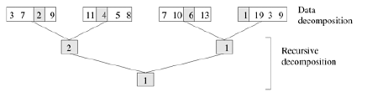
Decomposition Techniques-Hybrid Decompositions

Slide 50
Characteristics of Tasks and Interactions

Slide 51
Characteristics of Tasks and Interactions
The decomposition done previously allows us to identify the nature of concurrency in the problem and hence allow us to look into the kind of tasks that can be formulated.
Now we design a parallel algorithm that can take the decomposition and map it onto the available processors.
While mapping we take cue from the decomposition done before
In this section we will look into the nature of tasks and kind of interaction that is required between them to map them onto processors in an optimized way.

Slide 52
Characteristics of Tasks- Task generation
Task Generation The tasks that constitute a parallel algorithm may be generated either statically or dynamically.
Static task generation refers to the scenario where all the tasks are known before the algorithm starts execution.
Data decomposition usually leads to static task generation.
Examples of data-decomposition leading to a static task generation include matrix multiplication etc.
Recursive decomposition can also lead to a static task-dependency graph.
Finding the minimum of a list of numbers is an example of a static recursive task-dependency graph.

Slide 53
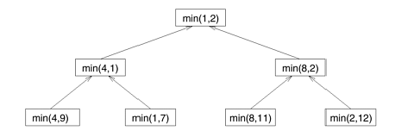
Static task generation example
Notes:
The task-dependency graph for finding the minimum number in the sequence {4, 9, 1, 7, 8, 11, 2, 12}. Each node in th tree represents the task of finding the minimum of a pair of numbers.

Slide 54
Dynamic task generation
Certain decompositions lead to a dynamic task generation during the execution of the algorithm.
In such decompositions, the actual tasks and the task-dependency graph are not explicitly available a priori, although the high level rules or guidelines governing task generation are known as a part of the algorithm.
Recursive decomposition can also lead to dynamic task generation.
For example, consider the recursive decomposition in quicksort.
The tasks are generated dynamically, and the size and shape of the task tree is determined by the values in the input array to be sorted.
An array of the same size can lead to task-dependency graphs of different shapes and with a different total number of tasks.

Slide 55
Characteristics of Tasks- Task Size
The size of a task is the relative amount of time required to complete it.
The complexity of mapping schemes often depends on whether or not the tasks are uniform; i.e., whether or not they require roughly the same amount of time.
If the amount of time required by the tasks varies significantly, then they are said to be non-uniform.
For example, the tasks in the decompositions for matrix multiplication shown in would be considered uniform.
On the other hand, the tasks in quicksort are non-uniform.

Slide 56
Characteristics of Tasks- knowledge of Task Size
Knowledge of Task Sizes The third characteristic that influences the choice of mapping scheme is knowledge of the task size.
If the size of all the tasks is known, then this information can often be used in mapping of tasks to processes.
For example, in the various decompositions for matrix multiplication discussed so far, the computation time for each task is known before the parallel program starts.

Slide 57
Characteristics of Tasks- size of Task data
Another important characteristic of a task is the size of data associated with it.
The reason this is an important consideration for mapping is that the data associated with a task must be available to the process performing that task, and the size and the location of these data may determine the process that can perform the task without incurring excessive data-movement overheads.
Different types of data associated with a task may have different sizes.
For instance, the input data may be small, but the output may be large, or vice versa.

Slide 58
Characteristics of Inter-Task Interactions
In any nontrivial parallel algorithm, tasks need to interact with each other to share data, work, or synchronization information.
Different parallel algorithms require different types of interactions among concurrent tasks.
The nature of these interactions makes them more suitable for certain programming paradigms and mapping schemes, and less suitable for others.
The types of inter-task interactions can be described along different dimensions, each corresponding to a distinct characteristic of the underlying computations.

Slide 59
Characteristics of Inter-Task Interactions - Static versus Dynamic
One way of classifying the type of interactions that take place among concurrent tasks is to consider whether or not these interactions have a static or dynamic pattern.
An interaction pattern is static if for each task, the interactions happen at predetermined times, and if the set of tasks to interact with at these times is known prior to the execution of the algorithm.
In other words, in a static interaction pattern, not only is the task interaction graph known a priori, but the stage of the computation at which each interaction occurs is also known.
An interaction pattern is dynamic if the timing of interactions or the set of tasks to interact with cannot be determined prior to the execution of the algorithm.

Slide 60
Characteristics of Inter-Task Interactions - Static versus Dynamic
Static interactions can be programmed easily in the message-passing paradigm, but dynamic interactions are harder to program.
The reason is that interactions in message-passing require active involvement of both interacting tasks – the sender and the receiver of information.
The unpredictable nature of dynamic iterations makes it hard for both the sender and the receiver to participate in the interaction at the same time.
Therefore, when implementing a parallel algorithm with dynamic interactions in the message-passing paradigm, the tasks must be assigned additional synchronization or polling responsibility.
Shared-address space programming can code both types of interactions equally easily.

Slide 61
Characteristics of Inter-Task Interactions - Regular versus Irregular
Another way of classifying the interactions is based upon their spatial structure.
An interaction pattern is considered to be regular if it has some structure that can be exploited for efficient implementation.
An interaction is called regular if it follows some particular patterns.
What patterns? How much data will be shared when will be shared
On the other hand, an interaction pattern is called irregular if no such regular pattern exists.
Irregular and dynamic communications are harder to handle, particularly in the message-passing programming paradigm.

Slide 62
Characteristics of Inter-Task Interactions - Read-only versus Read-Write
We have already learned that sharing of data among tasks leads to inter-task interaction.
However, the type of sharing may impact the choice of the mapping.
Data sharing interactions can be categorized as either read-only or read-write interactions.
As the name suggests, in read-only interactions, tasks require only a read-access to the data shared among many concurrent tasks.

Slide 63
Characteristics of Inter-Task Interactions - One-way versus Two-way
In some interactions, the data or work needed by a task, or a subset of tasks is explicitly supplied by another task or subset of tasks.
Such interactions are called two-way interactions and usually involve predefined producer and consumer tasks.
In other interactions, only one of a pair of communicating tasks initiates the interaction and completes it without interrupting the other one.
Such an interaction is called a one-way interaction.
All read-only interactions can be formulated as one-way interactions. Read-write interactions can be either one-way or two-way.

Slide 64
Mapping Techniques for Load Balancing
Section 3.4

Slide 65
Mapping Techniques for Load Balancing
Managing load over processors is called load balancing
In this we will use two terms
Objectives:
Small execution time
Reduce overhead of executing the tasks in parallel
Load
Task
Problem divided into subproblems
Actual work that we are mapping processor to perform task
Mapping
Allocating task on process
Balancing
Process
Computation Units
How to allocate task on processor that some processor should not have more load

Slide 66
Mapping Techniques for Load Balancing
Once a computation has been decomposed into tasks, these tasks are mapped onto processes with the objective that all tasks complete in the shortest amount of elapsed time.
In order to achieve a small execution time, the overheads of executing the tasks in parallel must be minimized.
For a given decomposition, there are two key sources of overhead.
The time spent in inter-process interaction is one source of overhead.
Another important source of overhead is the time that some processes may spend being idle. Some processes can be idle even before the overall computation is finished for a variety of reasons.
What reasons → error, exception, resource exhaustion, task termination signal etc.
Uneven load distribution may cause some processes to finish earlier than others.

Slide 67
Mapping Techniques for Load Balancing
At times, all the unfinished tasks mapped onto a process may be waiting for tasks mapped onto other processes to finish in order to satisfy the constraints imposed by the task-dependency graph.
Both interaction and idling are often a function of mapping.
Therefore, a good mapping of tasks onto processes must strive to achieve the twin objectives of
reducing the amount of time processes spend in interacting with each other, and
reducing the total amount of time some processes are idle while the others are engaged in performing some tasks.

Slide 68
Mapping Techniques for Load Balancing
These two objectives often conflict with each other.
For example, the objective of minimizing the interactions can be easily achieved by assigning sets of tasks that need to interact with each other onto the same process.
In most cases, such a mapping will result in a highly unbalanced workload among the processes.
In fact, following this strategy to the limit will often map all tasks onto a single process.
As a result, the processes with a lighter load will be idle when those with a heavier load are trying to finish their tasks.
Similarly, to balance the load among processes, it may be necessary to assign tasks that interact heavily to different processes.
Due to the conflicts between these objectives, finding a good mapping is a nontrivial problem.

Slide 69
Mapping Techniques for Load Balancing static vs dynamic mapping
Static Mapping: Static mapping techniques distribute the tasks among processes prior to the execution of the algorithm.
The choice of a good mapping in this case depends on several factors, including the knowledge of task sizes, the size of data associated with tasks, the characteristics of inter-task interactions, and even the parallel programming paradigm.
Algorithms that make use of static mapping are in general easier to design and program.

Slide 70
Mapping Techniques for Load Balancing static vs dynamic mapping
Dynamic Mapping: Dynamic mapping techniques distribute the work among processes during the execution of the algorithm.
If tasks are generated dynamically, then they must be mapped dynamically too.
If task sizes are unknown, then a static mapping can potentially lead to serious load-imbalances and dynamic mappings are usually more effective.
If the amount of data associated with tasks is large relative to the computation, then a dynamic mapping may entail moving this data among processes.
The cost of this data movement may outweigh some other advantages of dynamic mapping and may render a static mapping more suitable.
However, in a shared-address-space paradigm, dynamic mapping may work well even with large data associated with tasks if the interaction is read-only

Slide 71
Mapping Techniques for Load Balancing static vs dynamic mapping
Schemes for Static Mapping
Mapping based on data partitioning
→Array Distribution Schemes
Block Distributions
Cyclic and Block-Cyclic Distributions
Randomized Block Distribution
→Graph Partitioning
2. Mapping based on Task Partitioning
3. Hierarchical Mappings

Slide 72
Mapping Techniques for Load Balancing static vs dynamic mapping
Schemes for Dynamic Mapping
Centralized Schemes
Master Processes
Slave Processes
Distributed Schemes
Critical parameters of a distributed load balancing scheme are as follows:
1. How are the sending and receiving processes paired together?
2. Is the work transferred initiated by the sender or the receiver?
3. How much work is transferred in each exchange?
4. When is the work transferred performed?

Slide 73
assignment
Read at home and write a report on the following topics concerning mapping strategies.
Block distribution schemes for data mapping
Cyclic and block cyclic distributions
Randomized block distribution
Graph partitioning
Mapping based on Task partitioning
Hierarchical mapping

Slide 74
Methods for Containing Interaction Overheads
Section 3.5

Slide 75
Maximizing Data Locality
In most nontrivial parallel programs, the tasks executed by different processes require access to some common data.
For example, in sparse matrix-vector multiplication y = Ab, in which tasks correspond to computing individual elements of vector y, all elements of the input vector b need to be accessed by multiple tasks.
In addition to sharing the original input data, interaction may result if processes require data generated by other processes.
The interaction overheads can be reduced by using techniques that promote the use of local data or data that have been recently fetched.
Data locality enhancing techniques encompass a wide range of schemes that try to minimize the volume of nonlocal data that are accessed, maximize the reuse of recently accessed data, and minimize the frequency of accesses.

Slide 76
Maximizing Data Locality - Minimize Volume of Data-Exchange
This is akin to maximizing the temporal data locality, i.e., making as many of the consecutive references to the same data as possible.
Clearly, performing as much of the computation as possible using locally available data obviates the need for bringing in more data into local memory or cache for a process to perform its tasks.
As discussed previously, one way of achieving this is by using appropriate decomposition and mapping schemes.

Slide 77
Maximizing Data Locality - Minimize Volume of Data-Exchange
Another way of decreasing the amount of shared data that are accessed by multiple processes is to use local data to store intermediate results, and perform the shared data access to only place the final results of the computation.
For example, consider computing the dot product of two vectors of length n in parallel such that each of the p tasks multiplies n/p pairs of elements.
Rather than adding each individual product of a pair of numbers to the final result, each task can first create a partial dot product of its assigned portion of the vectors of length n/p in its own local location, and only access the final shared location once to add this partial result.
This will reduce the number of accesses to the shared location where the result is stored to p from n.

Slide 78
Maximizing Data Locality - Minimize Frequency of Interactions
Minimizing interaction frequency is important in reducing the interaction overheads in parallel programs because there is a relatively high startup cost associated with each interaction on many architectures.
Interaction frequency can be reduced by restructuring the algorithm such that shared data are accessed and used in large pieces.
Thus, by amortizing the startup cost over large accesses, we can reduce the overall interaction overhead, even if such restructuring does not necessarily reduce the overall volume of shared data that need to be accessed.

Slide 79
Maximizing Data Locality - Minimize Frequency of Interactions
On a shared address-space architecture, each time a word is accessed, an entire cache line containing many words is fetched.
If the program is structured to have spatial locality, then fewer cache lines are accessed.
On a message-passing system, spatial locality leads to fewer message-transfers over the network because each message can transfer larger amounts of useful data.
The number of messages can sometimes be reduced further on a message-passing system by combining messages between the same source-destination pair into larger messages if the interaction pattern permits and if the data for multiple messages are available at the same time, albeit in separate data structures.

Slide 80
Overlapping Computations with Interactions
“Overlapping interactions with computations" describes a critical strategy for improving the efficiency, performance, and responsiveness of computer systems.
This concept revolves around the idea of executing tasks concurrently or in parallel, allowing interactions with the system, such as input/output operations and computations, to overlap and run simultaneously rather than sequentially.
It's a response to the need for systems to be more responsive, to make better use of available resources, and to minimize wait times.
Overlapping interactions can be achieved through various techniques, including multithreading, parallel processing, and asynchronous programming.
Benefits : Systems that employ this approach experience reduced latency, increased responsiveness, and improved resource utilization.
Challenges: issues like race conditions and resource contention.

Slide 81
Overlapping Computations with Interactions: Example
Consider a typical scenario where a computer system performs tasks such as reading data from a storage device, processing that data, and then writing the results back to the storage. Without overlapping interactions, these tasks would occur sequentially, resulting in significant idle time as the system waits for I/O operations to complete before starting the computation phase. However, by employing overlapping interactions, the system can initiate the next task (e.g., computation) while the previous one (e.g., I/O) is still in progress. This concurrent execution of tasks optimizes the system's performance and improves overall efficiency.

Slide 82
Overlapping Computations with Interactions
The amount of time that processes spend waiting for shared data to arrive or to receive additional work after an interaction has been initiated can be reduced, often substantially, by doing some useful computations during this waiting time.
A simple way of overlapping is to initiate an interaction early enough so that it is completed before it is needed for computation.
To achieve this, we must be able to identify computations that can be performed before the interaction and do not depend on it.
Then the parallel program must be structured to initiate the interaction at an earlier point in the execution than it is needed in the original algorithm.
Typically, this is possible if the interaction pattern is spatially and temporally static (and therefore, predictable) or if multiple tasks that are ready for execution are available on the same process so that if one blocks to wait for an interaction to complete, the process can work on another task
Notes:
The reader should note that by increasing the number of parallel tasks to promote computation-interaction overlap, we are reducing the granularity of the tasks, which in general tends to increase overheads. Therefore, this technique must be used judiciously.

Slide 83
Overlapping Computations with Interactions
In certain dynamic mapping schemes, as soon as a process runs out of work, it requests and gets additional work from another process.
It then waits for the request to be serviced.
If the process can anticipate that it is going to run out of work and initiate a work transfer interaction in advance, then it may continue towards finishing the tasks at hand while the request for more work is being serviced.
Depending on the problem, estimating the amount of remaining work may be easy or hard.

Slide 84
Overlapping Computations with Interactions
In most cases, overlapping computations with interaction requires support from the programming paradigm, the operating system, and the hardware.
The programming paradigm must provide a mechanism to allow interactions and computations to proceed concurrently.
This mechanism should be supported by the underlying hardware. Disjoint address-space paradigms and architectures usually provide this support via non-blocking message passing primitives.
The programming paradigm provides functions for sending and receiving messages that return control to the user's program before they have actually completed.
Thus, the program can use these primitives to initiate the interactions, and then proceed with the computations.
If the hardware permits computation to proceed concurrently with message transfers, then the interaction overhead can be reduced significantly.

Slide 85
Overlapping Computations with Interactions
On a shared-address-space architecture, the overlapping of computations and interaction is often assisted by prefetching hardware.
In this case, an access to shared data is nothing more than a regular load or store instruction.
The prefetch hardware can anticipate the memory addresses that will need to be accessed in the immediate future, and can initiate the access in advance of when they are needed.
In the absence of prefetching hardware, the same effect can be achieved by a compiler that detects the access pattern and places pseudo-references to certain key memory locations before these locations are actually utilized by the computation.
The degree of success of this scheme is dependent upon the available structure in the program that can be inferred by the prefetch hardware and by the degree of independence with which the prefetch hardware can function while computation is in progress.

Slide 86
Replicating Data or Computations
Replication of data or computations is another technique that may be useful in reducing interaction overheads.
In some parallel algorithms, multiple processes may require frequent read-only access to shared data structure, such as a hash-table, in an irregular pattern.
Unless the additional memory requirements are prohibitive, it may be best in a situation like this to replicate a copy of the shared data structure on each process so that after the initial interaction during replication, all subsequent accesses to this data structure are free of any interaction overhead.

Slide 87
Replicating Data or Computations
In the shared-address-space paradigm, replication of frequently accessed read-only data is often affected by the caches without explicit programmer intervention.
Explicit data replication is particularly suited for architectures and programming paradigms in which read-only access to shared data is significantly more expensive or harder to express than local data accesses.
Therefore, the message-passing programming paradigm benefits the most from data replication, which may reduce interaction overhead and also significantly simplify the writing of the parallel program.

Slide 88
Replicating Data or Computations
Data replication, however, does not come without its own cost. Data replication increases the memory requirements of a parallel program.
The aggregate amount of memory required to store the replicated data increases linearly with the number of concurrent processes.
This may limit the size of the problem that can be solved on a given parallel computer.
For this reason, data replication must be used selectively to replicate relatively small amounts of data.

Slide 89
Overlapping Interactions with Other Interactions
If the data-transfer capacity of the underlying hardware permits, then overlapping interactions between multiple pairs of processes can reduce the effective volume of communication.
As an example of overlapping interactions, consider the commonly used collective communication operation of one-to-all broadcast in a message-passing paradigm with four processes P0, P1, P2, and P3.
A commonly used algorithm to broadcast some data from P0 to all other processes works as follows.
In the first step, P0 sends the data to P2. In the second step, P0 sends the data to P1, and concurrently, P2 sends the same data that it had received from P0 to P3.
The entire operation is thus complete in two steps because the two interactions of the second step require only one time step.

Slide 90
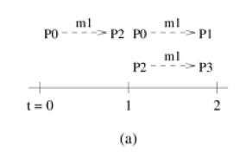
Overlapping Interactions with Other Interactions

Slide 91
Parallel Algorithm Models
Section 3.6

Slide 92
Parallel Algorithm Models
The Data-Parallel Model
The Task Graph Model
The Work Pool Model
The Master-Slave Model
The Pipeline or Producer-Consumer Model
Hybrid Models

Slide 93
Parallel Algorithm Models - The Data-Parallel Model
The data-parallel model is one of the simplest algorithm models.
In this model, the tasks are statically or semi-statically mapped onto processes and each task performs similar operations on different data.
This type of parallelism that is a result of identical operations being applied concurrently on different data items is called data parallelism.
The work may be done in phases and the data operated upon in different phases may be different.

Slide 94
Parallel Algorithm Models - The Task Graph Model
As discussed in previously, the computations in any parallel algorithm can be viewed as a task dependency graph.
In certain parallel algorithms, the task dependency graph is explicitly used in mapping.
In the task graph model, the interrelationships among the tasks are utilized to promote locality or to reduce interaction costs.
This model is typically employed to solve problems in which the amount of data associated with the tasks is large relative to the amount of computation associated with them.
Usually, tasks are mapped statically to help optimize the cost of data movement among tasks.

Slide 95
Parallel Algorithm Models - The Task Graph Model
Sometimes a decentralized dynamic mapping may be used, but even then, the mapping uses the information about the task-dependency graph structure and the interaction pattern of tasks to minimize interaction overhead.
Work is more easily shared in paradigms with globally addressable space, but mechanisms are available to share work in disjoint address space.
Typical interaction-reducing techniques applicable to this model include reducing the volume and frequency of interaction by promoting locality while mapping the tasks based on the interaction pattern of tasks and using asynchronous interaction methods to overlap the interaction with computation.
Examples of algorithms based on the task graph model include parallel quicksort, sparse matrix factorization, and many parallel algorithms derived via divide-and conquer decomposition.
This type of parallelism that is naturally expressed by independent tasks in a task-dependency graph is called task parallelism.

Slide 96
Parallel Algorithm Models - The Work Pool Model
The work pool or the task pool model is characterized by a dynamic mapping of tasks onto processes for load balancing in which any task may potentially be performed by any process.
There is no desired pre-mapping of tasks onto processes.
The mapping may be centralized or decentralized.
Pointers to the tasks may be stored in a physically shared list, priority queue, hash table, or tree, or they could be stored in a physically distributed data structure.
The work may be statically available in the beginning, or could be dynamically generated; i.e., the processes may generate work and add it to the global (possibly distributed) work pool.
If the work is generated dynamically and a decentralized mapping is used, then a termination detection algorithm would be required so that all processes can actually detect the completion of the entire program (i.e., exhaustion of all potential tasks) and stop looking for more work.

Slide 97
Parallel Algorithm Models - The Master-Slave Model
In the master-slave or the manager-worker model, one or more master processes generate work and allocate it to worker processes.
The tasks may be allocated a priori if the manager can estimate the size of the tasks or if a random mapping can do an adequate job of load balancing.
In another scenario, workers are assigned smaller pieces of work at different times.
The latter scheme is preferred if it is time consuming for the master to generate work and hence it is not desirable to make all workers wait until the master has generated all work pieces.
In some cases, work may need to be performed in phases, and work in each phase must finish before work in the next phases can be generated.

Slide 98
Parallel Algorithm Models - The Master-Slave Model
While using the master-slave model, care should be taken to ensure that the master does not become a bottleneck, which may happen if the tasks are too small (or the workers are relatively fast).
The granularity of tasks should be chosen such that the cost of doing work dominates the cost of transferring work and the cost of synchronization.
Asynchronous interaction may help overlap interaction and the computation associated with work generation by the master.
It may also reduce waiting times if the nature of requests from workers is non-deterministic.

Slide 99
Parallel Algorithm Models - The Pipeline or Producer-Consumer Model
In the pipeline model, a stream of data is passed on through a succession of processes, each of which perform some task on it.
This simultaneous execution of different programs on a data stream is called stream parallelism.
With the exception of the process initiating the pipeline, the arrival of new data triggers the execution of a new task by a process in the pipeline.
The processes could form such pipelines in the shape of linear or multidimensional arrays, trees, or general graphs with or without cycles.
A pipeline is a chain of producers and consumers.
Each process in the pipeline can be viewed as a consumer of a sequence of data items for the process preceding it in the pipeline and as a producer of data for the process following it in the pipeline.

Slide 100
Parallel Algorithm Models - Hybrid Models
In some cases, more than one model may be applicable to the problem at hand, resulting in a hybrid algorithm model.
A hybrid model may be composed either of multiple models applied hierarchically or multiple models applied sequentially to different phases of a parallel algorithm.
In some cases, an algorithm formulation may have characteristics of more than one algorithm model.
For instance, data may flow in a pipelined manner in a pattern guided by a task dependency graph.
In another scenario, the major computation may be described by a task dependency graph, but each node of the graph may represent a supertask comprising multiple subtasks that may be suitable for data-parallel or pipelined parallelism.
Parallel quicksort is one of the applications for which a hybrid model is ideally suited.

Slide 101

Thank You

